Slide 1
Lecture 8: Accounting and Dimension Hierarchy
Chapter 8

Slide 2
Accounting Processes
Accounting as support process in value chain
Accounting Processes
Journals/ledger entry
Invoicing
Account receivable/payable
Fixed asset
Budgeting
DW/BI system provides a single source of usable, understandable financial information.
Notes:
Accounting Processes
Journal- All transactions are recorded in a journal as debit credit
Accounts – different accounts are debited or credited
Ledger – Sales, Purchase, General (Asset, Liabilities, Income, Expense, Capital)
Purpose-

Slide 3
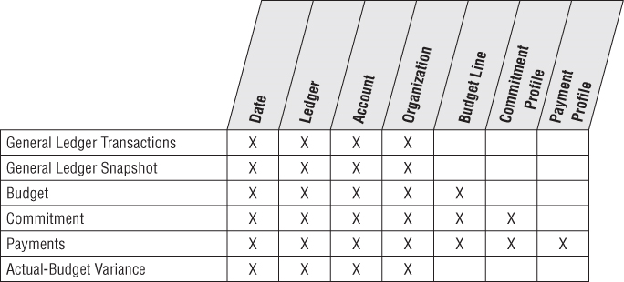
Bus Matrix Rows for Accounting Processes

Slide 4
Accounting Dimensional Model
﻿General Ledger Data
﻿The general ledger (G/L) is a core foundation financial system that ties together the detailed information collected by subledgers or separate systems for purchasing, payables (what you owe to others), and receivables (what others owe you).

Slide 5
Accounting Dimensional Model
1. General Ledger Periodic Snapshot
Snapshot of general ledger account at the end of each fiscal period
Grain: One row per accounting period.
2. General Ledge Journal Transaction Fact Table
Grain is one row for every general ledger entry
Each row in the journal entry fact table is identified as either a credit or a debit

Slide 6
﻿General Ledger Periodic Snapshot
﻿Chart of Accounts
﻿The cornerstone of the general ledger is the chart of accounts.
﻿Period Close
Analyzing the closed financial results;

Slide 7
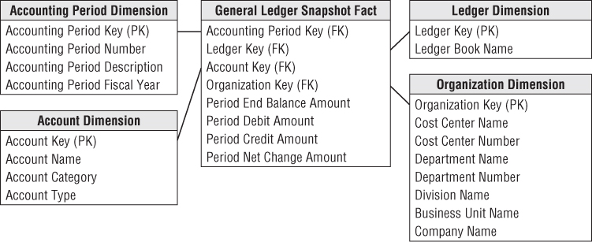
General Ledger Periodic Snapshot
﻿General ledger account balances at the end of each accounting period: ﻿account rankings, trending patterns, and period-to-period comparisons

Slide 8
Important Dimensions
﻿The ledger dimension is a convenient and intuitive dimension that enables multiple ledgers to be stored in the same fact table.
﻿every query that accesses this fact table must constrain the ledger dimension to a single value (for example, Final Approved Domestic Ledger)
﻿The account dimension is carefully derived from the uniform chart of accounts in the enterprise.
The organization dimension describes the financial reporting entities in the enterprise.

Slide 9
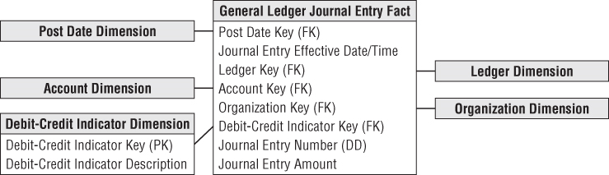
General Ledger Journal Entry Transaction

Slide 10
﻿General Ledger Journal Transactions
﻿Each row in the journal entry fact table is identified as either a credit or a debit.
The debit/credit indicator takes on two, and only two, values.
﻿Capture journal entry transactions by transaction posting date, so use a daily-grained date table in this schema;
﻿The journal entry number is likely a degenerate dimension with no linkage to an associated dimension table.

Slide 11
A Multilevel Hierarchy in General Ledger

Slide 12
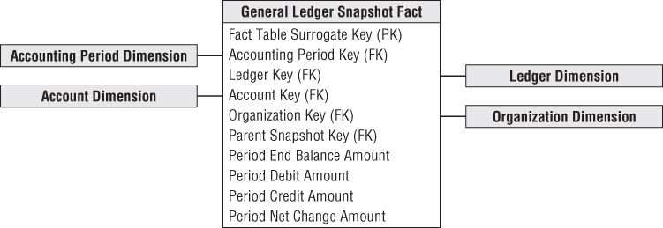
Drilling Down a Multilevel Hierarchy
Multiple ledgers arranged in ascending hierarchy
Department -> division -> enterprise
High level ledger entry

Slide 13
Roll Up and Drill Down
Roll-up performs aggregation in any of the following ways:
By climbing up a concept hierarchy for a dimension
By dimension reduction
Initially the concept hierarchy was "street < city < province < country".
On rolling up, the data is aggregated by ascending the location hierarchy from the level of city to the level of country.

Slide 14
Roll Up and Drill Down
Drill-down is the reverse operation of roll-up. It is performed by either of the following ways:
By stepping down a concept hierarchy for a dimension
By introducing a new dimension.
Initially the concept hierarchy was "day < month < quarter < year."
On drilling down, the time dimension is descended from the level of quarter to the level of month.

Slide 15
Budgeting Process
Budgeting chain is a series of fact tables
Budget Fact -> Establish budget for each division and account
Commitment Fact -> Make commitments against each budget
Payment Fact -> Make payments against each commitments

Slide 16
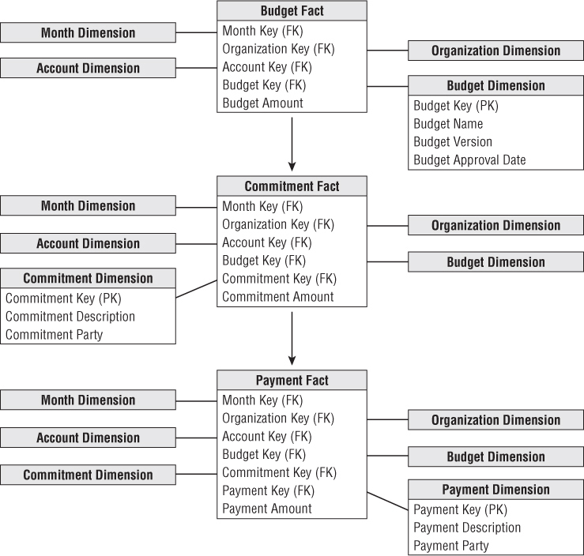
Chain of Budget Processes

Slide 17
Budget Fact Table
﻿For an expense budget line item, each row identifies what an organization in the company is allowed to spend for what purpose during a given time frame.
﻿If the line item reflects an income forecast, which is just another variation of a budget, it would identify what an organization intends to earn from what source during a time frame.
﻿Budget amount fact is fully additive;

Slide 18
Commitment Fact Table
﻿When the budget year begins, managers make commitments to spend the budget through purchase orders, work orders, or other forms of contracts.
In addition, the specific commitment document (purchase order, work order, or contract) and commitment party.
The fact is the committed amount.

Slide 19
Payment Fact Table
﻿Finally, payments are made as monies are transferred to the party named in the commitment.
﻿The finance department is interested in the relationship between commitments and payments because it manages the company’s cash.
The dimensions associated with the payments fact table would include the commitment fact table dimensions, a payment dimension to identify the type of payment, the payee to whom the payment was actually made.

Slide 20
Hierarchies
Fixed Depth Positional Hierarchies
Slightly Ragged Variable Depth Hierarchy
Ragged Hierarchies

Slide 21
Fixed Depth Positional Hierarchy
Has fixed set of levels
Day -> month -> year (Many-to-one)
Day -> fiscal period -> year
Manager level -> director level -> executive level

Slide 22
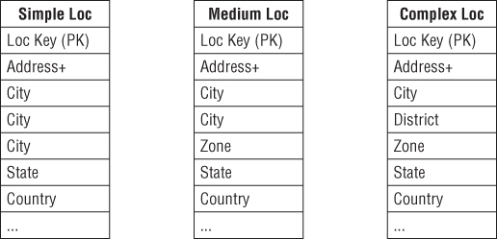
Slightly Ragged Variable Depth Hierarchy
Geographic hierarchy
Simple Location: Address -> city -> state -> country
Medium Location: Address -> city -> zone -> state -> country
Complex Location: Address -> city -> District -> zone -> state -> country
Notes:
Ragged hierarchy pg 216
Recursive keys (pg 217) hard to maintain with type 2 changes – cascade.

Slide 23
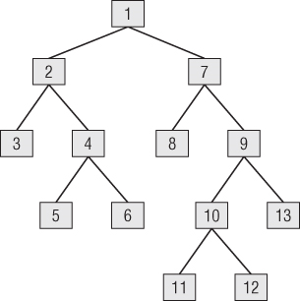
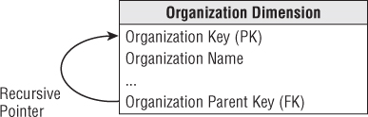
Ragged Variable Depth Hierarchy (Tree)
Organization structure hierarchy: Arbitrary rollup
Use recursive pointers from each row to its parent.
However, recursive pointers are hard to maintain with type 2 changes due to the cascading effect.
Notes:
Ragged hierarchy pg 216
Recursive keys (pg 217) hard to maintain with type 2 changes – cascade.

Slide 24
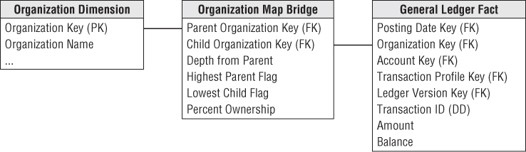
Ragged Variable Depth Hierarchy (Tree)
How to represent arbitrary rollup structures?
Build a bridge table that is independent of from the primary dimension table and contains all information about the rollup.
Notes:
Ragged hierarchy pg 216
Recursive keys (pg 217) hard to maintain with type 2 changes – cascade.

Slide 25
Organization Map Bridge Table
﻿The grain of this bridge table is each path in the tree from a parent to all the children below that parent;
﻿The first column in the map table is the primary key of the parent, and the second column is the primary key of the child.
﻿A row must be constructed from each possible parent to each possible child, including a row that connects the parent to itself.
The highest parent flag in the map table means the particular path comes from the highest parent in the tree. The lowest child flag means the particular path ends in a “leaf node” of the tree

Slide 26
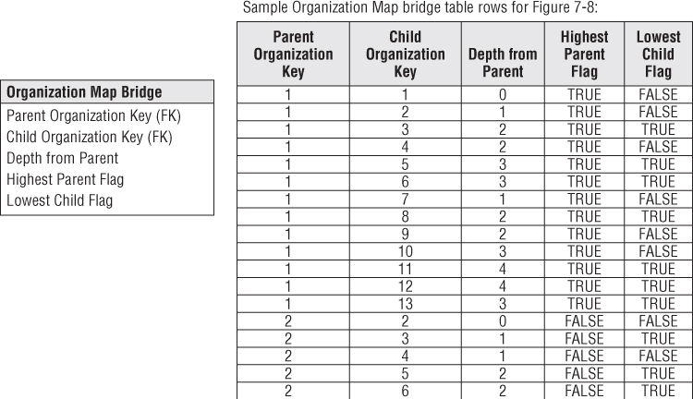
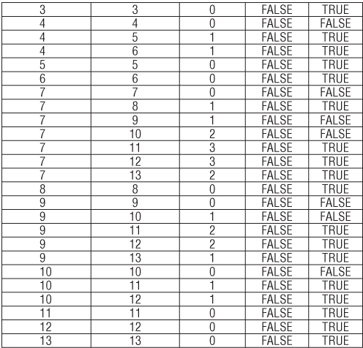

Slide 27
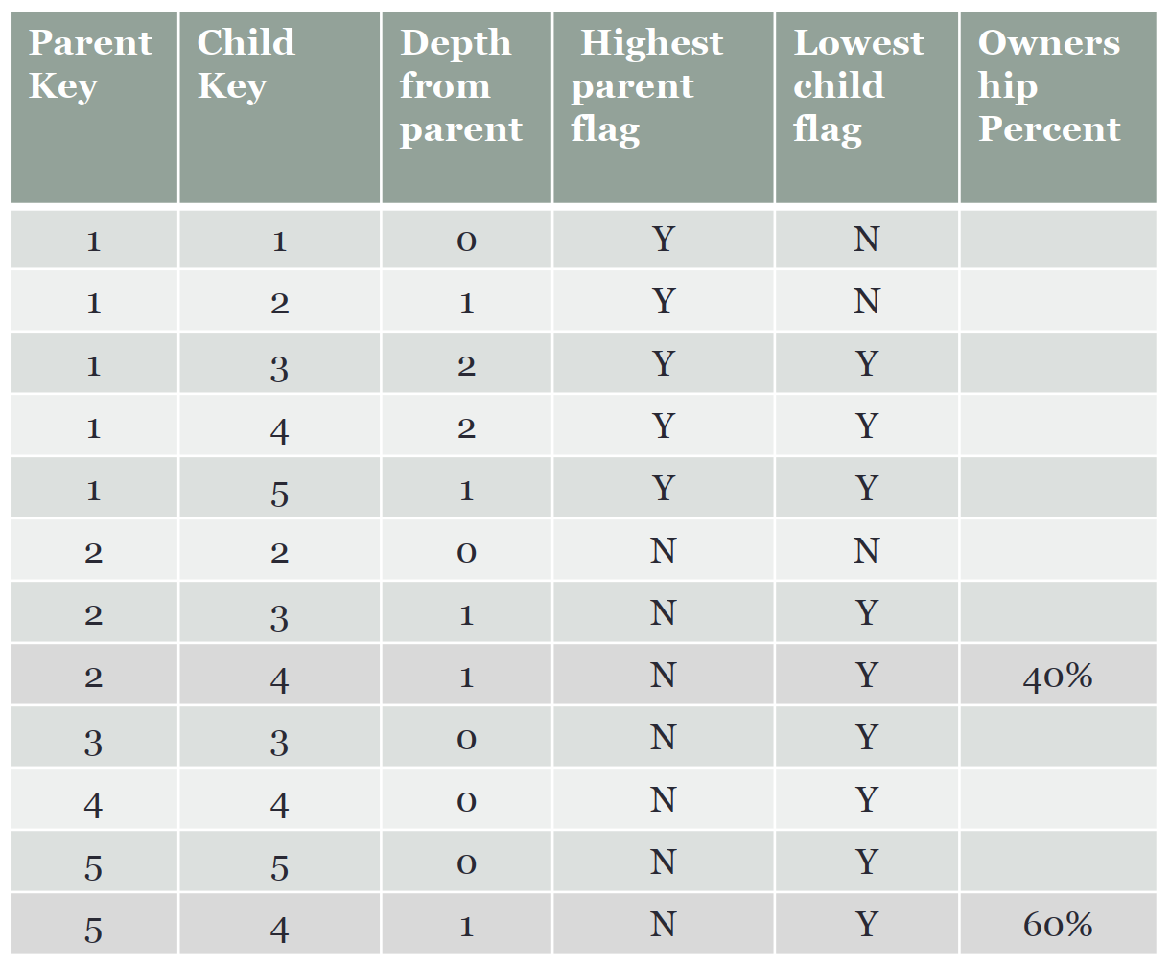
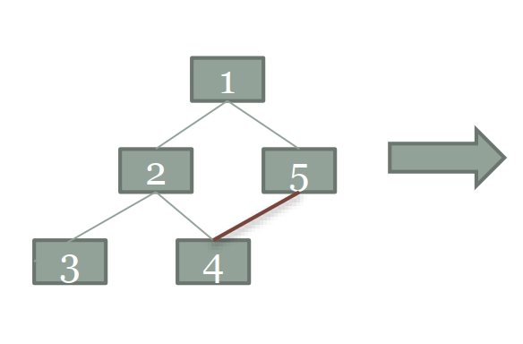
﻿Shared Ownership in a Ragged Hierarchy
﻿The map table can represent partial or shared ownership:
Node 4 is 60% owned by node 5, and 40% owned by node 2;
﻿Example of a shared ownership.

Slide 28
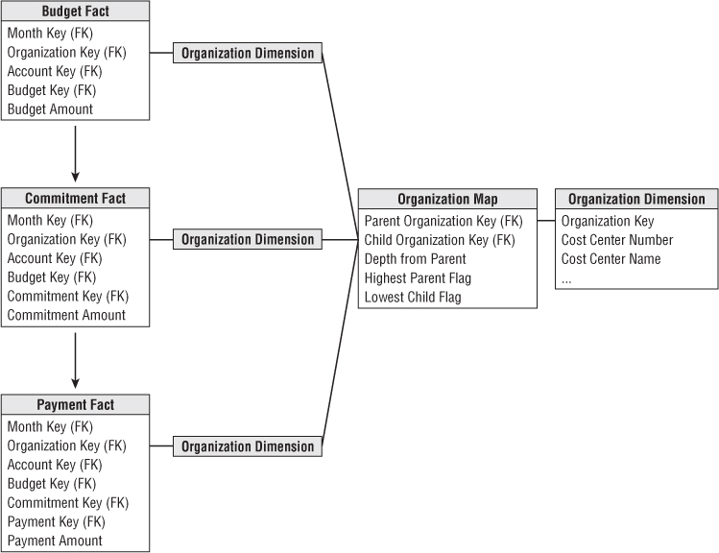
Drill Across and Rolling Up the Budget Chain
Drill Across
Rolling Up
Notes:
Ragged hierarchy pg 216
Recursive keys (pg 217) hard to maintain with type 2 changes – cascade.

